Slide 1
Agent: Title/use
Give a short name to the agent:
"A library reservation making agent"
Give a short summary of the agent's use or goals:
"It gives a user a way to easily find and reserve a study space at any of the Berlin libraries the user has access to"
Also put your name, semester, and group (A Smith, SoSe26, A+B) on this slide

Slide 2
Next slide is what environment/context does it operate in:
Use the Russell & Norvig Environment Model to summarize where your agent would be operating. Do not spend more than 30 seconds on this - we'll get it fast.
Fully observable vs partially observable, etc - Example below
Environmental Property |  |  | Reasoning
Observable | Fully Observable | Partially Observable | entire board visible
Deterministic vs Stochastic | Deterministic | Stochastic | moves have predictable outcomes
Episodic vs Sequential | Episodic | Sequential | current moves affect game outcome
Static vs Dynamic | Static | Dynamic | opponent moves only when agent moves
Discrete vs Continuous | Discrete | Continuous | board positions, piece movements
Single vs Multi-agent | Single | Multi | opponent player taking actions to change states

Slide 3
One slide of the presentation should be on the data you used:
Where did it come from?
What does it represent?
Where did it come from?
What ongoing sensor/data sources would the agent be working with?
Show one sample or a summary of a sample of the data
Any problems with the data (unbalanced classes, missing data, anomalies)
Data fields | Field 1..6 | Other fields | Labels/categories

Slide 4
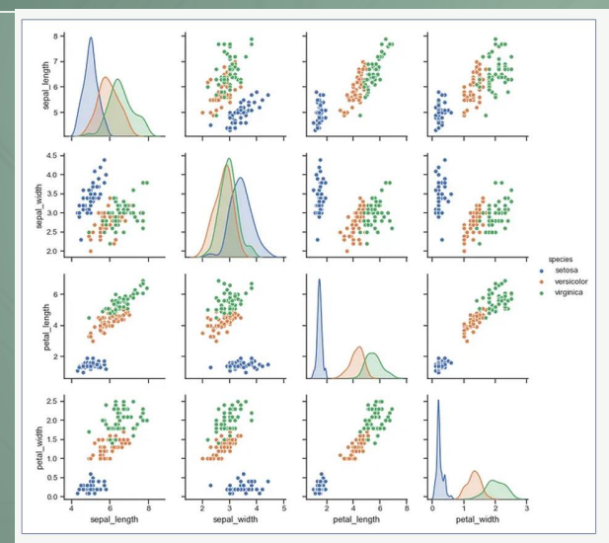
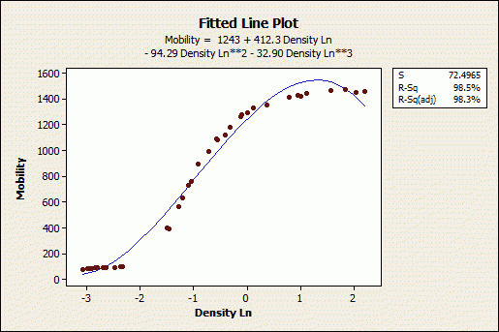
One slide showing at least one inspection/analysis of that data:
It could be one or more covariance charts
It could be statistics on the data
Anything that shows me you looked at the data itself to try to understand the structure or shape of it.

Slide 5
What kind of model/algorithm did you choose to work with?
Is it supervised, unsupervised, reinforcement, semi-supervised, ensemble, etc
Basically show us the structure of your agent (it might be a box with Neural Network - supervised with backpropagation) on it.
Note any major parameters you set (size of the neural network, clustering limits, K in K-means, etc)
If you worked with multiple ones, feel free to show both on the same slide, but also realize we'll be moving fast during the presentation, so focus on the one you got to work the best and spent the most time considering/analyzing for your agent's needs

Slide 6
Results of your model's training
Accuracy, confusion matrix, other outcomes
How'd it do? Any ideas on how to make it better?

Slide 7
Final slide of the presentation should answer some of these questions about the model you built on the data
How could that learned model be used in your agent-based system?
What would the model enable the agent to understand?
What would the model enable the agent to learn and/or make decisions on?

